Slide 1
Question 1
Prim’s

Slide 2
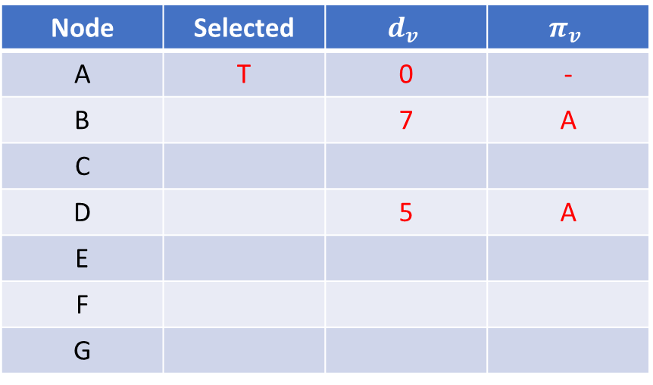
A
7
8
C
Node | Selected | $$d_{v}$$ | $$π_{v}$$
A | T | 0 | -
B |  | 7 | A
C
D |  | 5 | A
E
F
G
B
5
7
9
E
5
15
D
9
8
F
G
6
11

Slide 3
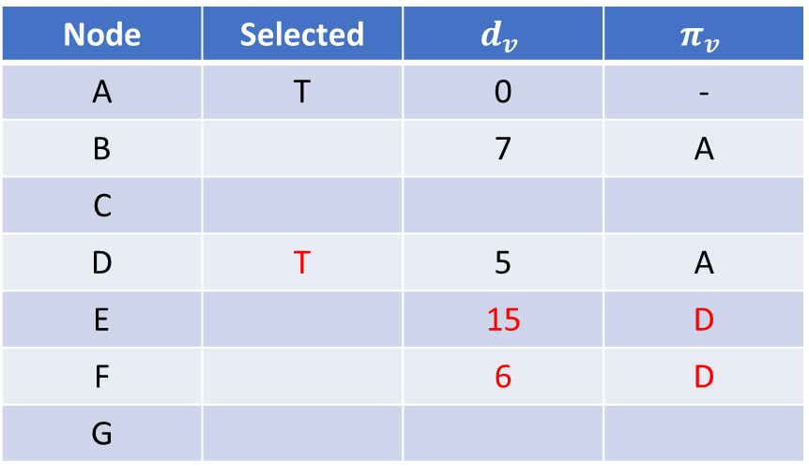
A
7
8
C
Node | Selected | $$d_{v}$$ | $$π_{v}$$
A | T | 0 | -
B |  | 7 | A
C
D | T | 5 | A
E |  | 15 | D
F |  | 6 | D
G
B
5
7
9
E
5
15
D
9
8
F
G
6
11

Slide 4
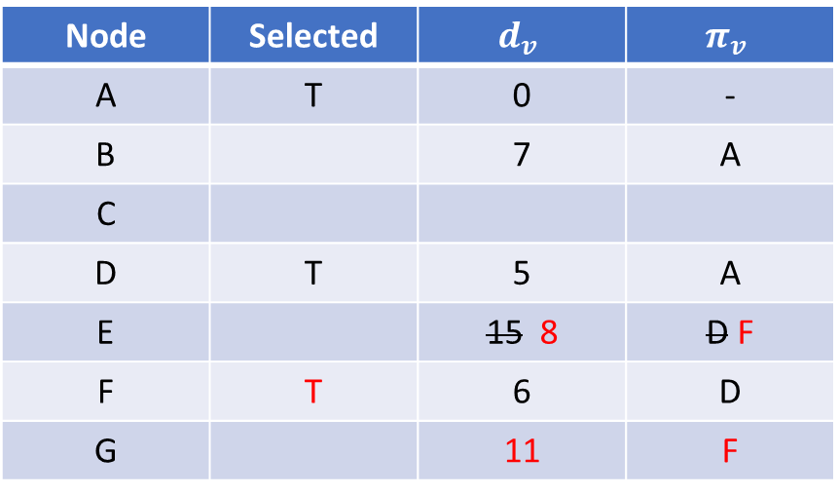
A
7
8
C
Node | Selected | $$d_{v}$$ | $$π_{v}$$
A | T | 0 | -
B |  | 7 | A
C
D | T | 5 | A
E |  | 15 8 | D F
F | T | 6 | D
G |  | 11 | F
B
5
7
9
E
5
15
D
9
8
F
G
6
11

Slide 5
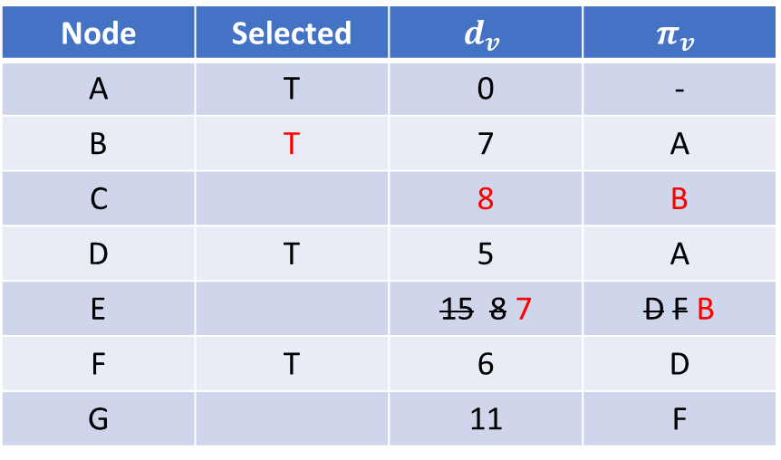
A
7
8
C
Node | Selected | $$d_{v}$$ | $$π_{v}$$
A | T | 0 | -
B | T | 7 | A
C |  | 8 | B
D | T | 5 | A
E |  | 15 8 7 | D F B
F | T | 6 | D
G |  | 11 | F
B
5
7
9
E
5
15
D
9
8
F
G
6
11

Slide 6
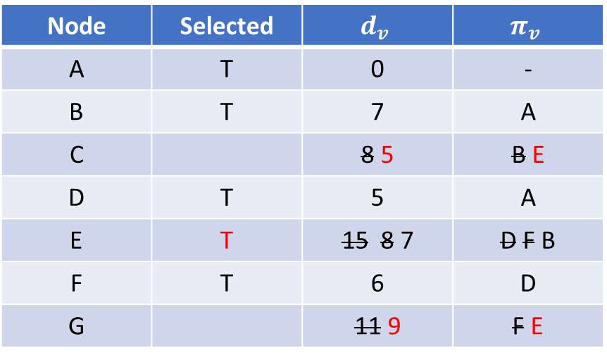
A
7
8
C
Node | Selected | $$d_{v}$$ | $$π_{v}$$
A | T | 0 | -
B | T | 7 | A
C |  | 8 5 | B E
D | T | 5 | A
E | T | 15 8 7 | D F B
F | T | 6 | D
G |  | 11 9 | F E
B
5
7
9
E
5
15
D
9
8
F
G
6
11

Slide 7
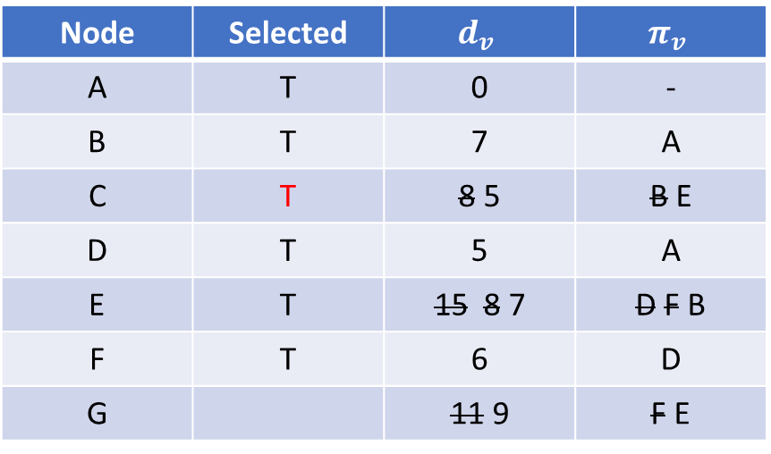
A
7
8
C
Node | Selected | $$d_{v}$$ | $$π_{v}$$
A | T | 0 | -
B | T | 7 | A
C | T | 8 5 | B E
D | T | 5 | A
E | T | 15 8 7 | D F B
F | T | 6 | D
G |  | 11 9 | F E
B
5
7
9
E
5
15
D
9
8
F
G
6
11

Slide 8
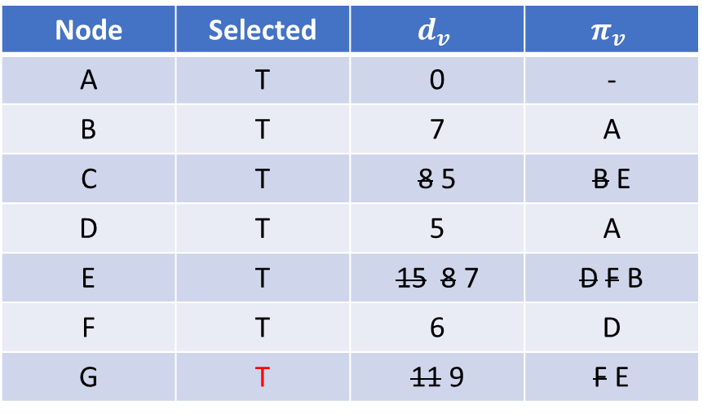
A
7
8
C
Node | Selected | $$d_{v}$$ | $$π_{v}$$
A | T | 0 | -
B | T | 7 | A
C | T | 8 5 | B E
D | T | 5 | A
E | T | 15 8 7 | D F B
F | T | 6 | D
G | T | 11 9 | F E
B
5
7
9
E
5
15
D
9
8
F
G
6
11

Slide 9
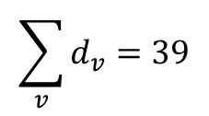
A
7
C
Node | Selected | $$d_{v}$$ | $$π_{v}$$
A | T | 0 | -
B | T | 7 | A
C | T | 8 5 | B E
D | T | 5 | A
E | T | 15 8 7 | D F B
F | T | 6 | D
G | T | 11 9 | F E
B
5
7
E
5
D
9
F
G
6
$$\sum_{v}{d_{v}=39}$$

Slide 10
Question 1
Kruskal’s

Slide 11
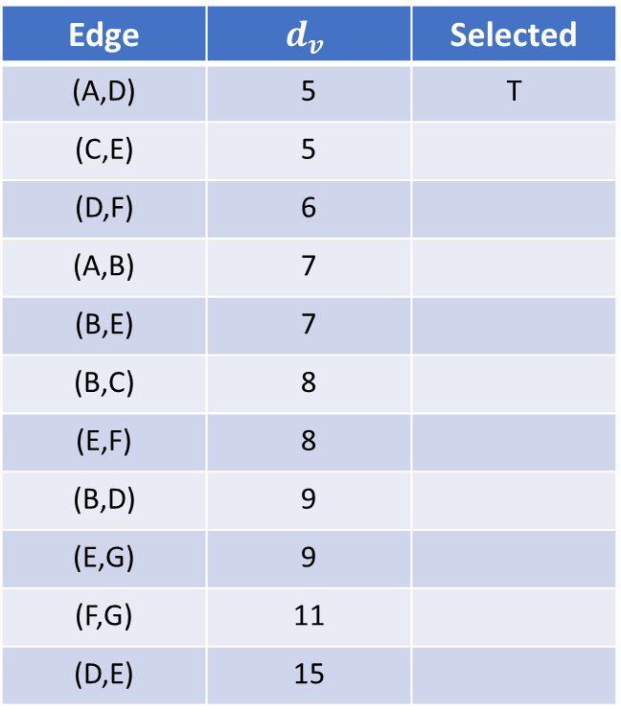
8
C
Edge | $$d_{v}$$ | Selected
(A,D) | 5 | T
(C,E) | 5
(D,F) | 6
(A,B) | 7
(B,E) | 7
(B,C) | 8
(E,F) | 8
(B,D) | 9
(E,G) | 9
(F,G) | 11
(D,E) | 15
A
7
B
5
7
9
E
5
15
D
9
8
F
G
6
11

Slide 12

8
C
Edge | $$d_{v}$$ | Selected
(A,D) | 5 | T
(C,E) | 5 | T
(D,F) | 6
(A,B) | 7
(B,E) | 7
(B,C) | 8
(E,F) | 8
(B,D) | 9
(E,G) | 9
(F,G) | 11
(D,E) | 15
A
7
B
5
7
9
E
5
15
D
9
8
F
G
6
11

Slide 13
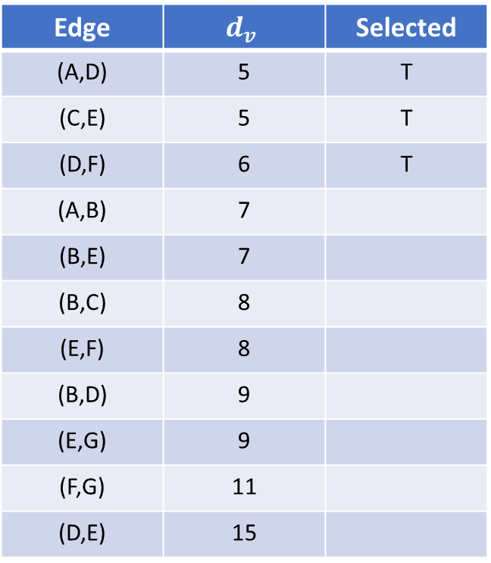
8
C
Edge | $$d_{v}$$ | Selected
(A,D) | 5 | T
(C,E) | 5 | T
(D,F) | 6 | T
(A,B) | 7
(B,E) | 7
(B,C) | 8
(E,F) | 8
(B,D) | 9
(E,G) | 9
(F,G) | 11
(D,E) | 15
A
7
B
5
7
9
E
5
15
D
9
8
F
G
6
11

Slide 14
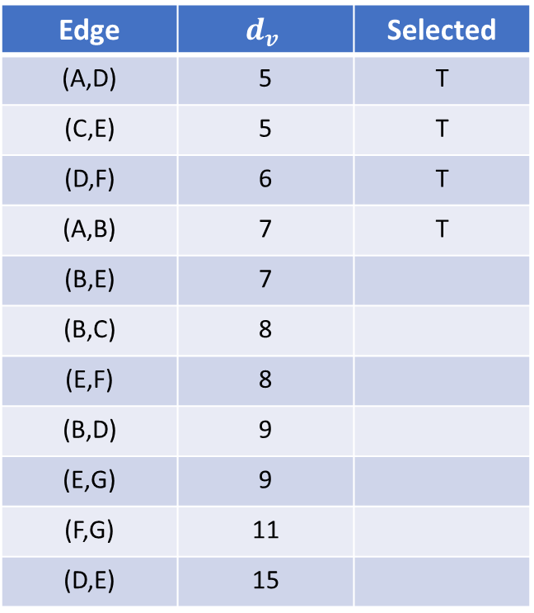
8
C
Edge | $$d_{v}$$ | Selected
(A,D) | 5 | T
(C,E) | 5 | T
(D,F) | 6 | T
(A,B) | 7 | T
(B,E) | 7
(B,C) | 8
(E,F) | 8
(B,D) | 9
(E,G) | 9
(F,G) | 11
(D,E) | 15
A
7
B
5
7
9
E
5
15
D
9
8
F
G
6
11

Slide 15

8
C
Edge | $$d_{v}$$ | Selected
(A,D) | 5 | T
(C,E) | 5 | T
(D,F) | 6 | T
(A,B) | 7 | T
(B,E) | 7 | T
(B,C) | 8
(E,F) | 8
(B,D) | 9
(E,G) | 9
(F,G) | 11
(D,E) | 15
A
7
B
5
7
9
E
5
15
D
9
8
F
G
6
11

Slide 16

8
C
Edge | $$d_{v}$$ | Selected
(A,D) | 5 | T
(C,E) | 5 | T
(D,F) | 6 | T
(A,B) | 7 | T
(B,E) | 7 | T
(B,C) | 8 | F
(E,F) | 8
(B,D) | 9
(E,G) | 9
(F,G) | 11
(D,E) | 15
A
7
B
5
7
9
E
5
15
D
9
8
F
G
6
11

Slide 17
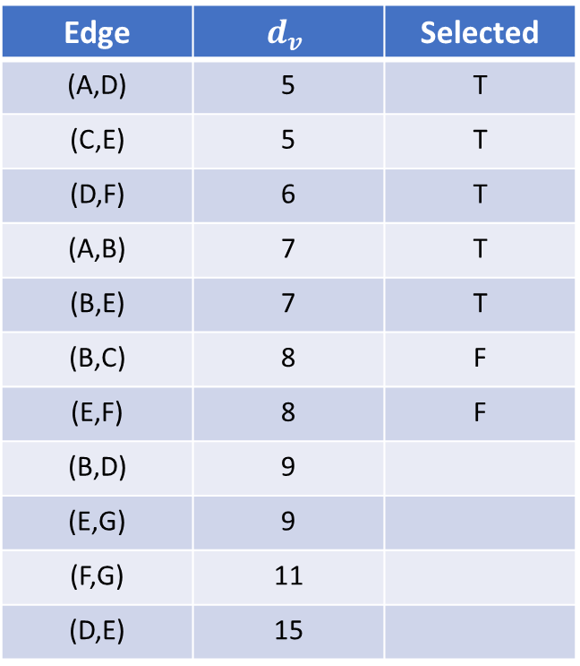
8
C
Edge | $$d_{v}$$ | Selected
(A,D) | 5 | T
(C,E) | 5 | T
(D,F) | 6 | T
(A,B) | 7 | T
(B,E) | 7 | T
(B,C) | 8 | F
(E,F) | 8 | F
(B,D) | 9
(E,G) | 9
(F,G) | 11
(D,E) | 15
A
7
B
5
7
9
E
5
15
D
9
8
F
G
6
11

Slide 18
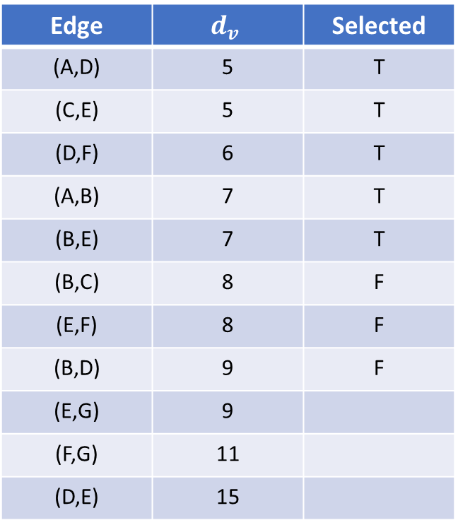
8
C
Edge | $$d_{v}$$ | Selected
(A,D) | 5 | T
(C,E) | 5 | T
(D,F) | 6 | T
(A,B) | 7 | T
(B,E) | 7 | T
(B,C) | 8 | F
(E,F) | 8 | F
(B,D) | 9 | F
(E,G) | 9
(F,G) | 11
(D,E) | 15
A
7
B
5
7
9
E
5
15
D
9
8
F
G
6
11

Slide 19
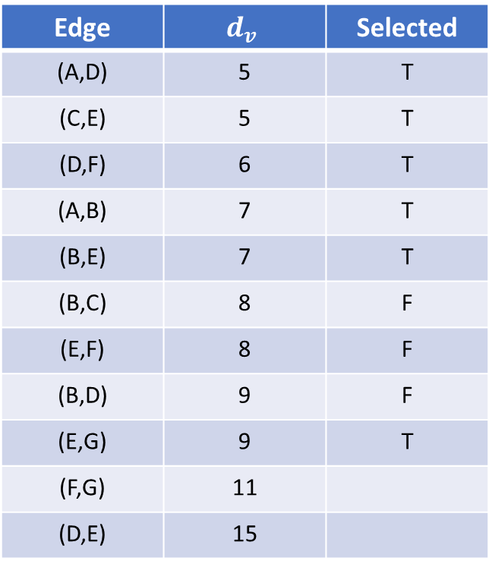
8
C
Edge | $$d_{v}$$ | Selected
(A,D) | 5 | T
(C,E) | 5 | T
(D,F) | 6 | T
(A,B) | 7 | T
(B,E) | 7 | T
(B,C) | 8 | F
(E,F) | 8 | F
(B,D) | 9 | F
(E,G) | 9 | T
(F,G) | 11
(D,E) | 15
A
7
B
5
7
9
E
5
15
D
9
8
F
G
6
11

Slide 20
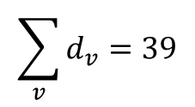
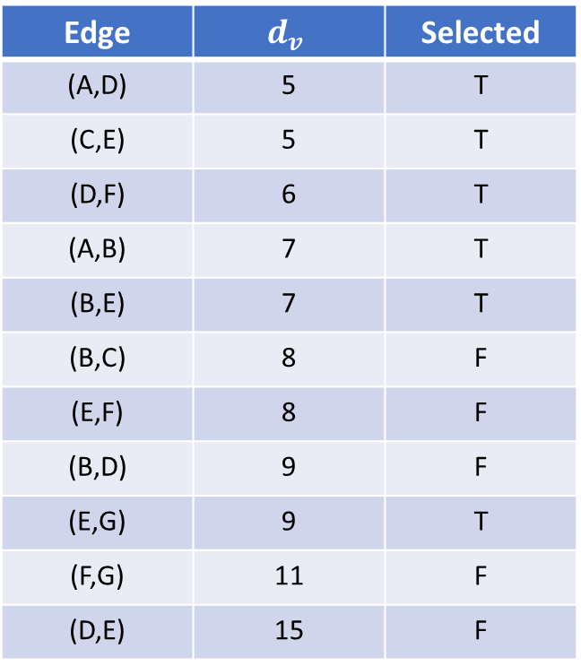
C
Edge | $$d_{v}$$ | Selected
(A,D) | 5 | T
(C,E) | 5 | T
(D,F) | 6 | T
(A,B) | 7 | T
(B,E) | 7 | T
(B,C) | 8 | F
(E,F) | 8 | F
(B,D) | 9 | F
(E,G) | 9 | T
(F,G) | 11 | F
(D,E) | 15 | F
A
7
B
5
7
E
5
D
9
F
G
6
$$\sum_{v}{d_{v}=39}$$

